Slide 1
Sui Course 2023 / Part 2-2

Slide 2
Parameter Passing and Object Deletion

Slide 3
Agenda
Parameter Passing
Object Deletion and Struct Unpacking

Slide 4
Parameter Passing

Slide 5


Demystifying Parameter Passing
PARAMETERS
Pass-by-mutable-reference
Pass-by-value
Pass-by-reference
FUNCTION
Execution
Notes:
Understanding the significance of parameter passing is essential as it enables functions to process values or objects within a program. This forms one of the fundamental means by which data traverses through a software application - moving from one function to another. Grasping how parameter passing operates can aid in coding more efficiently and accurately.
In Sui Move, parameter passing generally employs three methods:
Pass-by-value: The function obtains a duplicate of the argument instead of the original variable. Any modifications made to the parameter within the function do not impact the original data.
Pass-by-reference: Contrarily, the function receives a reference to the original data rather than a copy. This permits the function to both read and alter the original data.
Pass-by-mutable-reference: Analogous to pass-by-reference, but also allows the function to modify the original data. This method is prevalent in languages like Rust.

Slide 6
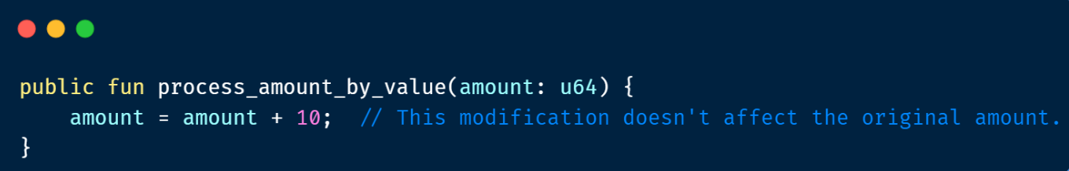
Pass by Value
Notes:
Pass by Value: In this method, a copy of the argument's value is created and passed to the function. The original value remains unchanged regardless of any modification made within the function. Here's an example:
In this example, the process_amount_by_value function receives a u64 type parameter amount. It then tries to increment it. However, since amount is passed by value, this modification doesn't affect the original amount.

Slide 7
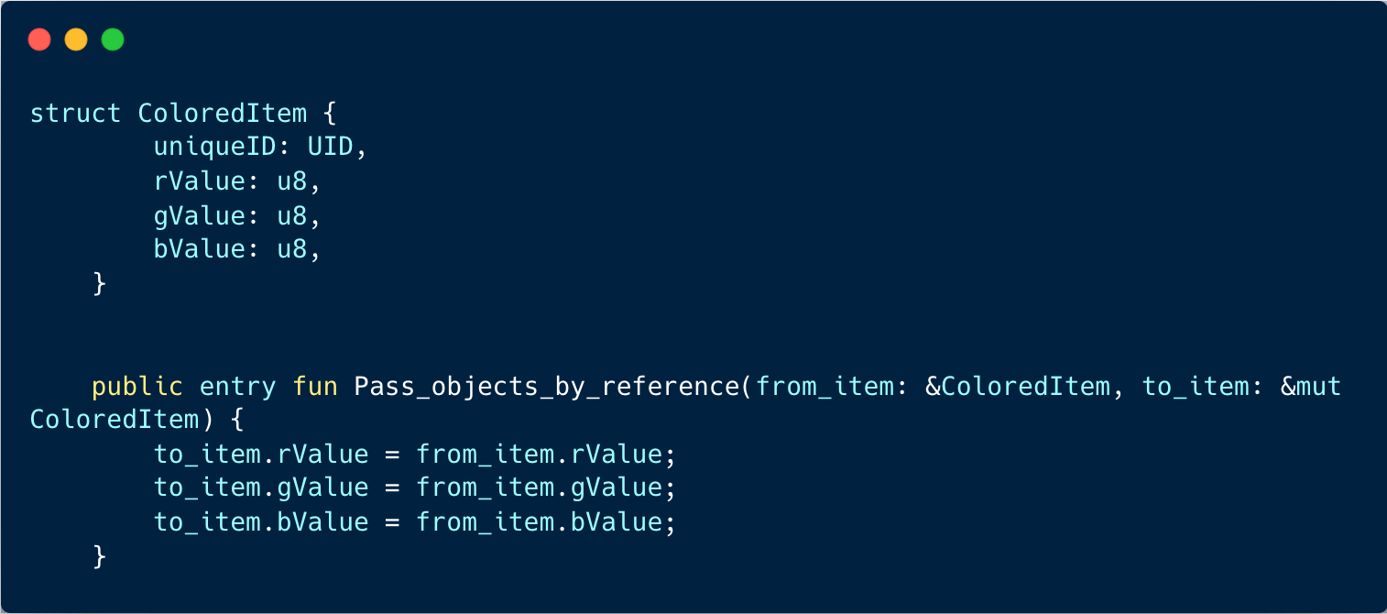
Pass by Reference
Notes:
This code defines a structure named ColoredItem that represents an object with color properties. The properties include a uniqueID of type UID (presumably representing a unique identifier), and three color components: rValue for red, gValue for green, and bValue for blue, all of type u8 (unsigned 8-bit integer).
The code also contains a public entry function named Pass_objects_by_reference. This function takes two parameters: from_item, a reference to a ColoredItem object that you want to copy from, and to_item, a mutable reference to a ColoredItem object that you want to copy the values into.
Inside the function, the color component values (rValue, gValue, and bValue) of the from_item are copied into the corresponding color component values of the to_item. This effectively copies the color properties from one ColoredItem object to another.

Slide 8
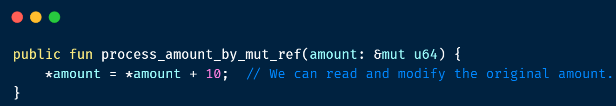
Pass by Mutable Reference
Notes:
Pass by Mutable Reference: This method is similar to pass by reference, but it also allows the function to modify the original data. Here's an example:
In this example, the process_amount_by_mut_ref function receives a mutable reference to a u64 type parameter amount. It can read and increment the original amount.

Slide 9
Object Deletion and Struct Unpacking

Slide 10
Object Deletion
Object deletion in sui move is an essential technique that aids in
effective storage management and is a critical aspect of maintaining the integrity and efficiency of your blockchain applications
Notes:
Object deletion is a crucial concept in programming, particularly in languages that deal with object-oriented programming or that utilize complex data structures. It refers to the process of removing an object from memory once it is no longer needed. This can be particularly important in managing memory usage and preventing memory leaks in your programs.
The importance of object deletion lies in its role in memory management. As programs execute, they often create and manipulate various objects. Over time, some of these objects may no longer be needed - perhaps their data has been processed, or the program flow has moved beyond the point where they are relevant. If these objects are not properly deleted, they continue to occupy memory, leading to inefficient memory use and potentially causing your program to run out of memory.
In Sui Move, object deletion takes on heightened importance. As a language tailored for blockchain and smart contract development, Sui Move functions within an environment where judicious memory usage is vital. Smart contracts often need to preserve their state over extended durations, and inefficient memory utilization can result in escalated costs or even execution failures.
Furthermore, object deletion in Sui Move is not as straightforward as merely expunging an object from memory. Given the blockchain's nature, a system must be in place to manage the elimination of objects along with the correlated data.

Slide 11
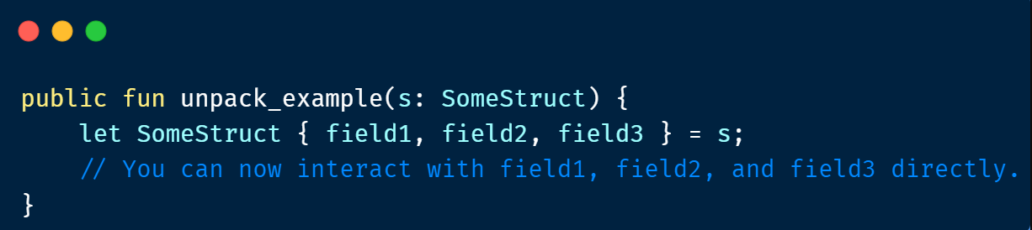
Struct Unpacking
Struct unpacking in sui move is a crucial technique that allows for effective data manipulation, and is especially important when handling object deletion.
Notes:
In programming, "struct unpacking" refers to the process of extracting the individual values from a struct (a compound data type that groups together variables of different types) and assigning them to separate variables. This allows the programmer to work with the struct's individual components directly.
In sui move, the concept of struct unpacking is essential due to the language's strict rules regarding how data structures are handled. Sui move, designed for creating blockchain-based applications, places a lot of emphasis on data security and encapsulation. As a result, a struct's fields are only accessible inside the module that defines the struct. If you want to modify or interact with a struct outside its defining module, you have to unpack it first.
Here's a simple example:
In this example, SomeStruct is a struct with fields field1, field2, and field3. Inside the unpack_example function, SomeStruct is unpacked, and its fields are assigned to the variables field1, field2, and field3.
This process of unpacking is necessary when deleting an object in sui move. You must first unpack the object to retrieve its ID, which can then be used to delete the object from the system.

Slide 12
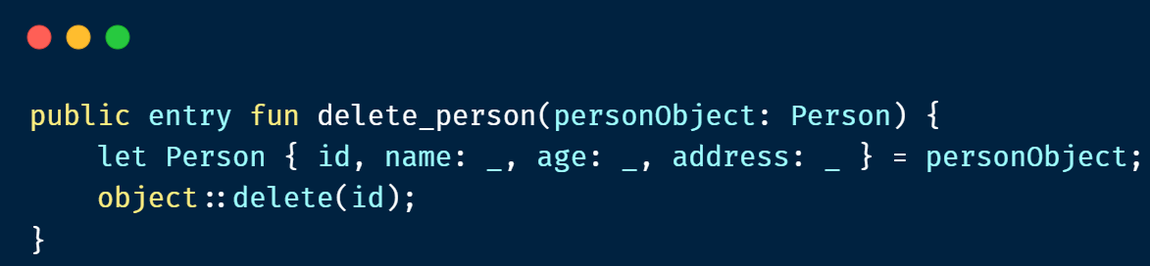
Example
Notes:
In this example, we have a delete_person function that takes a Person object as a parameter and deletes it.
Function Declaration: public entry fun delete_person(personObject: Person) { ... }. This function is declared as a public entry function and takes a Person object named personObject as a parameter.
Struct Unpacking: let Person { id, name: _, age: _, address: _ } = personObject;. Here, the personObject is unpacked to access its internal fields. We are only interested in the id field, so the other fields (name, age, address) are ignored using _.
Object Deletion: object::delete(id);. Finally, the object::delete(id) method is called to delete the object with the specified id.
This example demonstrates how to delete an object based on a Person struct. By unpacking the object and accessing its fields, we can retrieve the necessary identifier and pass it to the object::delete method for deletion.

